Slide 1

Noise-Proof Forests: Replicating and Testing Tree-Based Models on Common Tabular Datasets
Group Members: Aysha Mukhtar, Anthony Jerez-Tenecela, Jahed Ullah, Youssef Moussa

Slide 2
Introduction
Why Study Label Noise in Tree-Based Models:
Label noise (incorrect labels) is common in real-world machine learning datasets
It can reduce model accuracy and reliability, especially in tree-based models
We test how Random Forest, XGBoost, and LightGBM perform under 10–30% label noise
Also explore fixes like early stopping and robust loss to improve model resilience

Slide 3
Related Work
What Recent Research Shows:
Rajpurkar et al. (2025): Small label noise causes noticeable drops in Accuracy and AUC in Random Forest & XGBoost
Li & Zhang (2024): Introduced robust loss functions (non-convex) that improved performance on corrupted data
Kim et al. (2024): Found class-dependent noise is worse than random noise; tested noise-tolerant gradient boosting
Chen et al. (2024): Showed early stopping, label smoothing, and robust loss helped make models more noise-resistant
Frénay & Verleysen (2022): Proved noise type matters. Class-based noise is harder to deal with

Slide 4
What We’re Replicating
Replicating Prior Work on Label Noise
Inspired by studies on how label noise affects tree-based model performance
Prior work introduced synthetic noise into datasets and evaluated model robustness
We test Random Forest, XGBoost, and LightGBM on noisy data
Also replicate mitigation strategies: early stopping, label smoothing, robust loss

Slide 5
First Data Set: Bank Marketing Dataset (UCI Repository)
45,000+ rows of marketing data to predict term deposit subscriptions
Target: Whether the client subscribed (Yes/No)
Features: 16 total (categorical + numerical)
Label noise added at 10%, 20%, and 30% levels post train-test split

Slide 6
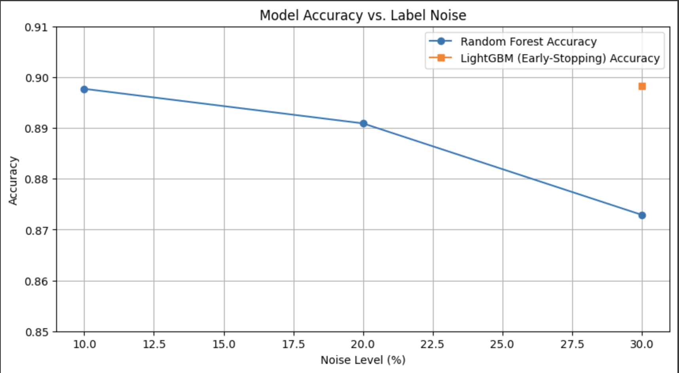
Random Forest shows declining accuracy from 0.8977 → 0.8729
LightGBM with early stopping stays strong at 30% noise: 0.8983
Shows early stopping may help retain accuracy under noise

Slide 7
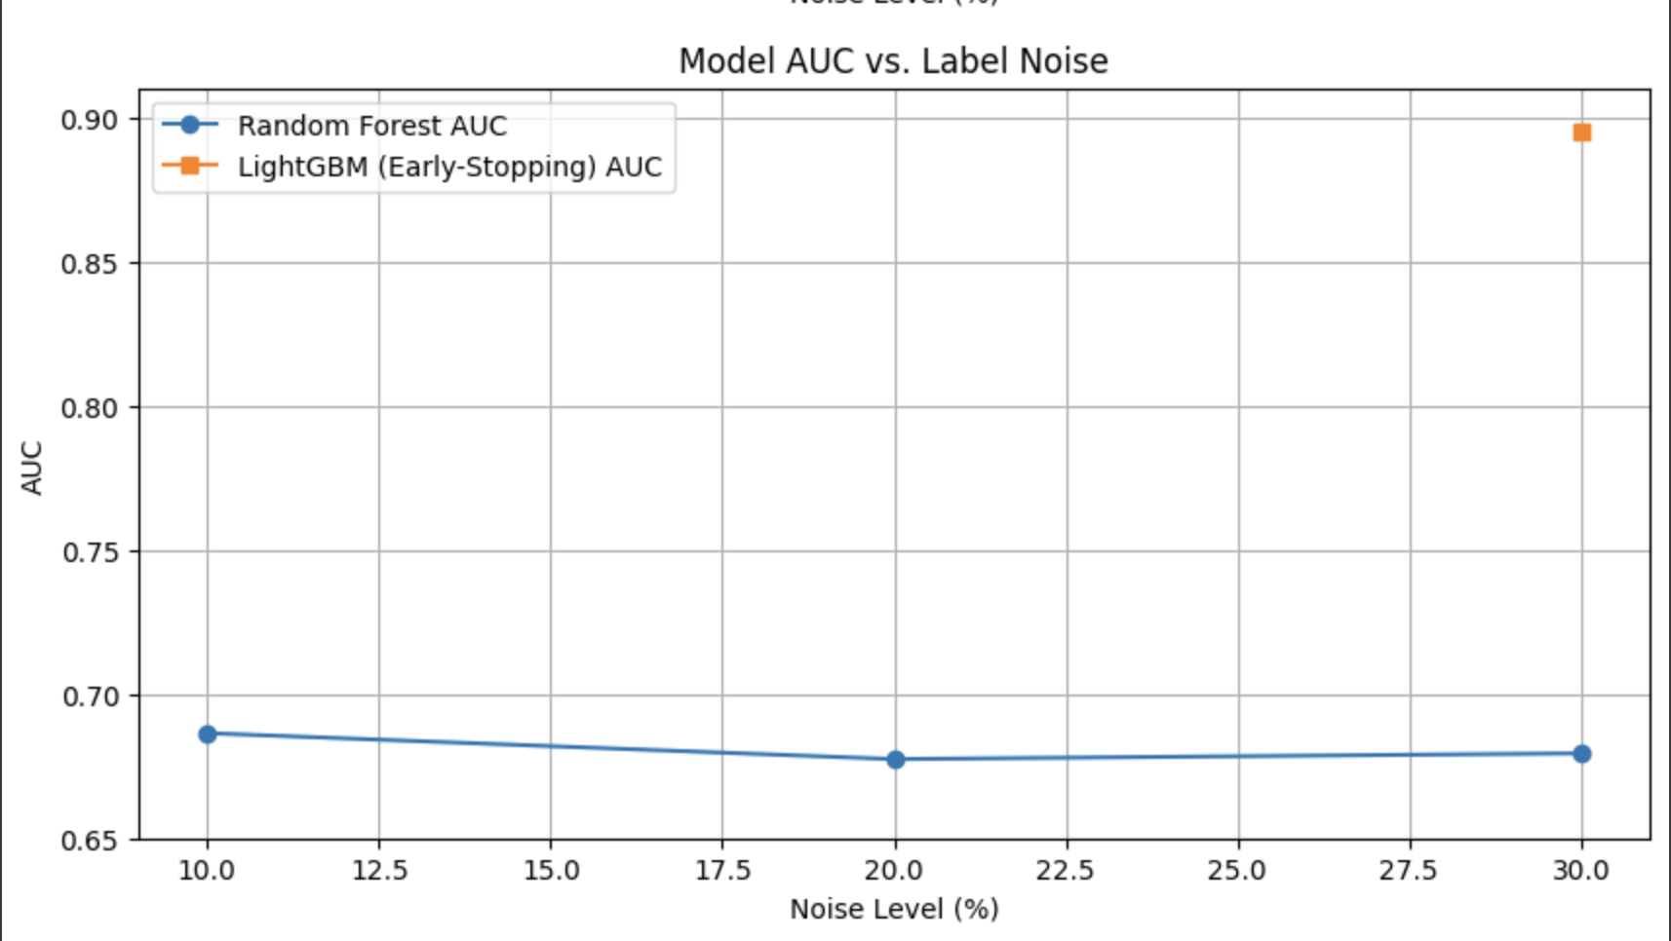
Random Forest AUC remains low and stable around 0.67–0.68
LightGBM with early stopping peaks at 0.8948 under 30% noise
Suggests LightGBM is more robust with regularization techniques

Slide 8
Bank Data Set Results
Results support earlier findings: label noise hurts model performance
Random Forest is fairly stable but still affected
LightGBM with early stopping and proper tuning remains highly robust
Confirms that simple techniques (early stopping, regularization) improve reliability

Slide 9
Second DataSet: IBM Telco Customer Churn
Approach: Replicate recent research findings by injecting random flips at the 0%, 10%, 20%, and 30% levels into the Telco-Churn target and evaluate performance under noisy labels.
Models: Random Forest, XGBoost, LightGBM
MItigations tested:
Early stopping for XGBoost and LightGBM.
Label smoothing for LightGBM
Data splits:
80% train, 20%test
Inside train, 10% validation slice for early stopping for select models

Slide 10
Data Pre-processing
Dataset has over 7,000 rows, 21 attributes, and the target Churn
Cleaning:
Drop non-informative column: customerID
Cast TotalCharges to float
Feature Engineering:
One-hot encode categorical columns
Keep numeric features unscaled

Slide 11
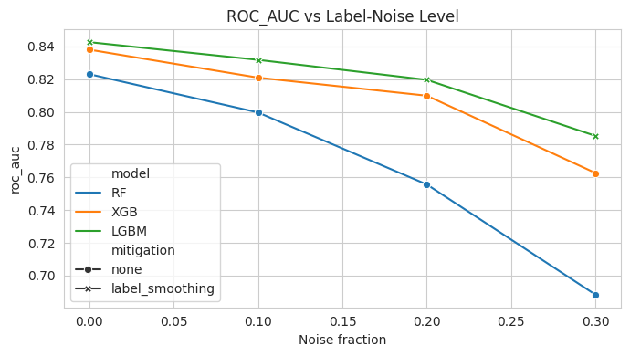
Analysis & Results
Analysis:
LightGBM stays on top, outperforming the others at every noise level
XGBoost holds up while Random Forest degrades the fastest
Results:
Tree-boosting with early stopping is robust to moderate levels of label noise
Additional label smoothing shows marginal benefit as well
Random Forest falls the fastest as noise rises, indicating the need for mitigation techniques

Slide 12
3rd Dataset: IBM HR Analytics Employee Attrition Dataset (Introduction & Motivation)
Predicting employee attrition is critical for HR, but real‐world labels often contain errors (e.g. survey mistakes, data entry typos).
We inject 0 %, 10 %, 20 %, and 30 % random flips into the Attrition labels to simulate real‐world noise.
Measure how tree-based models (Random Forest, XGBoost, LightGBM) degrade under label noise and evaluate two lightweight fixes—noise filtering and instance weighting.

Slide 13
Dataset & Preprocessing Details
Dataset: HR Employee Attrition (1470 employees, 35 features).
No missing values detected: reliable survey data.
Encoded categorical variables and created binary target AttritionFlag.
Feature distributions inspected to ensure balanced representation.

Slide 14
Experimental Methodology
Train/Test Split: 80/20 stratified to preserve attrition ratio.
Noise Injection: Randomly flip 0%, 10%, 20%, 30% of labels.
Baseline Models: Random Forest, XGBoost, LightGBM with early stopping.
Mitigation Strategies:
Noise Filtering: drop low‐confidence samples (threshold=0.7)
Instance Weighting: weight samples by model confidence
Metrics: Accuracy for overall correctness, F1 for class balance, AUC for ranking.

Slide 15
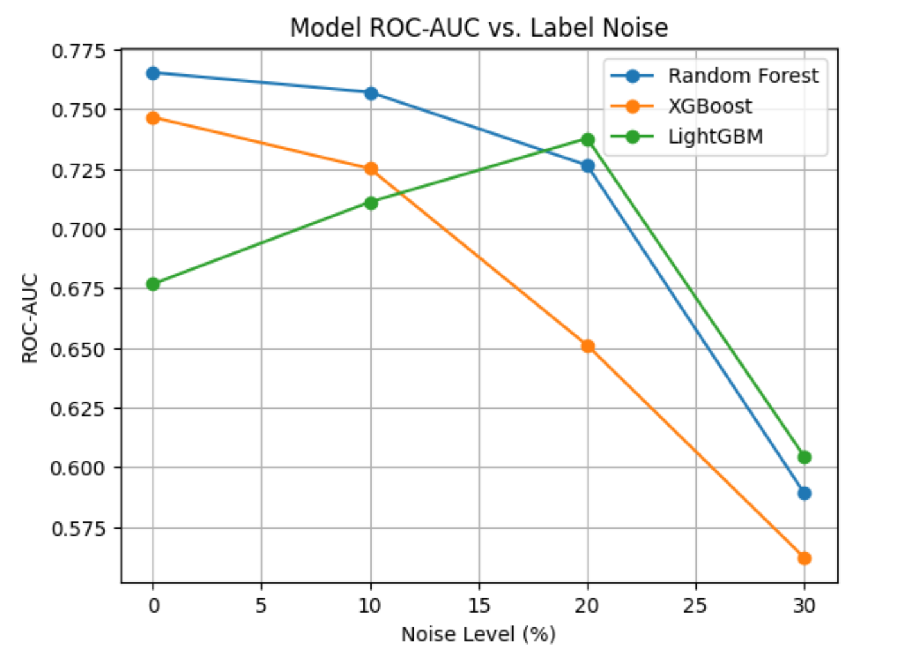
Baseline Results Analysis
Random Forest: ROC-AUC drops from 0.765 at 0% noise to 0.589 at 30%
XGBoost (early stopping): ROC-AUC drops from 0.747 to 0.562 (0% -> 30%).
LightGBM (early stopping): ROC-AUC drops from 0.677 to 0.605.
All models suffer under label noise; boosting helps at low noise but none alone is sufficient at high noise levels.

Slide 16
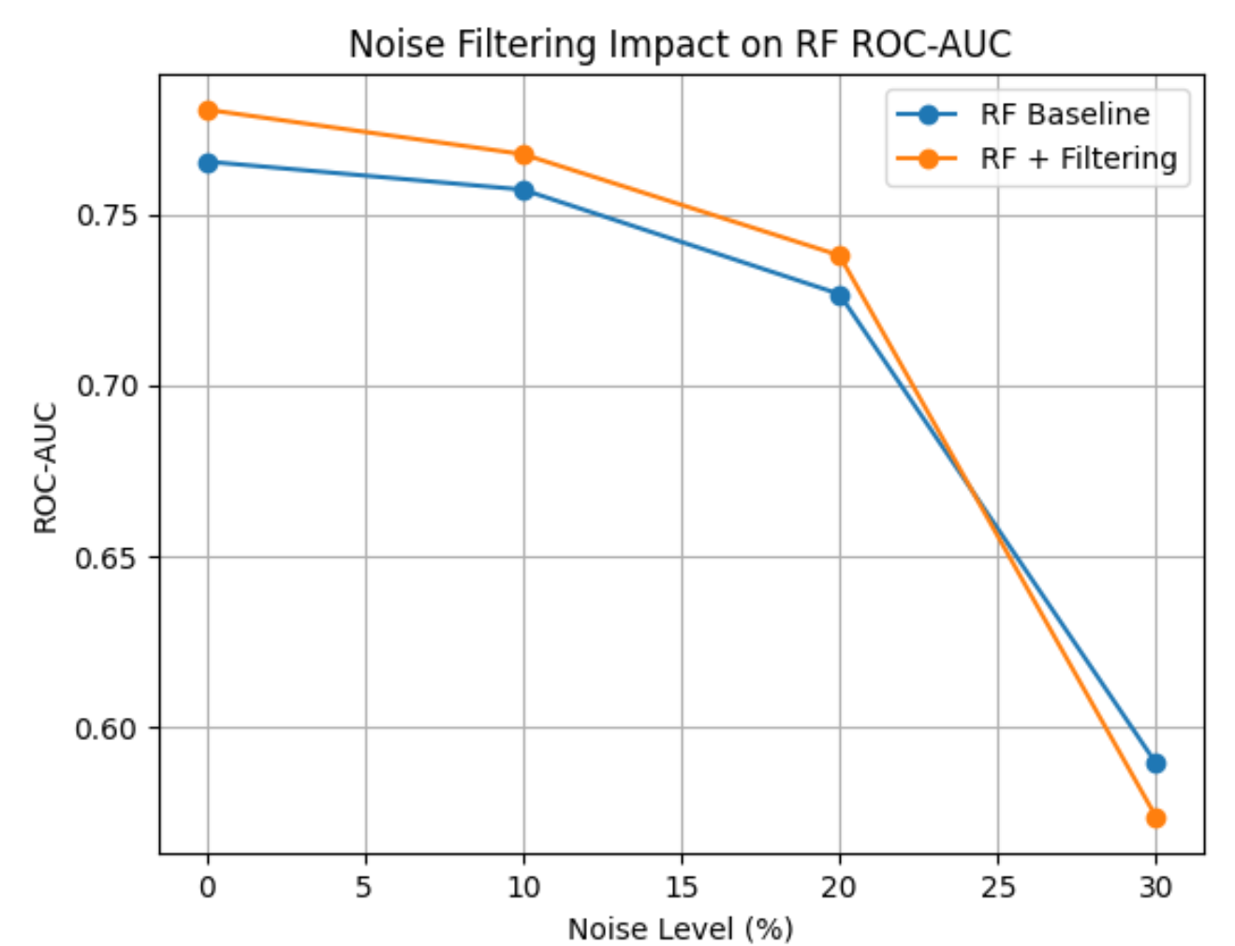
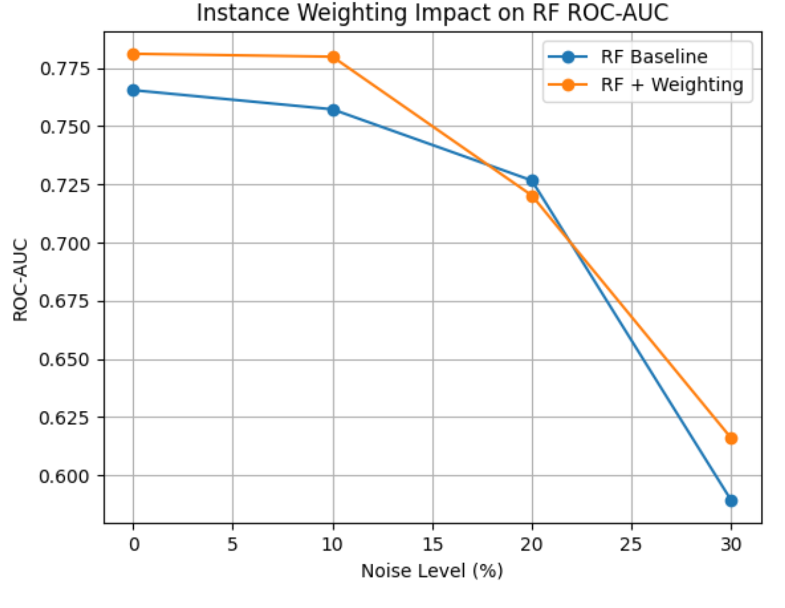
Mitigation Strategies
Noise Filtering: Remove samples whose predicted probability for their (noisy) label < 0.7, effective under mild noise but over‐filters when noise is heavy.
Result: +0.011 AUC at 10–20% noise; –0.015 AUC at 30% noise
Instance Weighting: Assign each training sample a weight = model’s confidence in its noisy label, best recovery under heavy noise, retains more data by down-weighting rather than dropping
Result: +0.023 AUC at 10% noise; +0.027 AUC at 30% noise

Slide 17
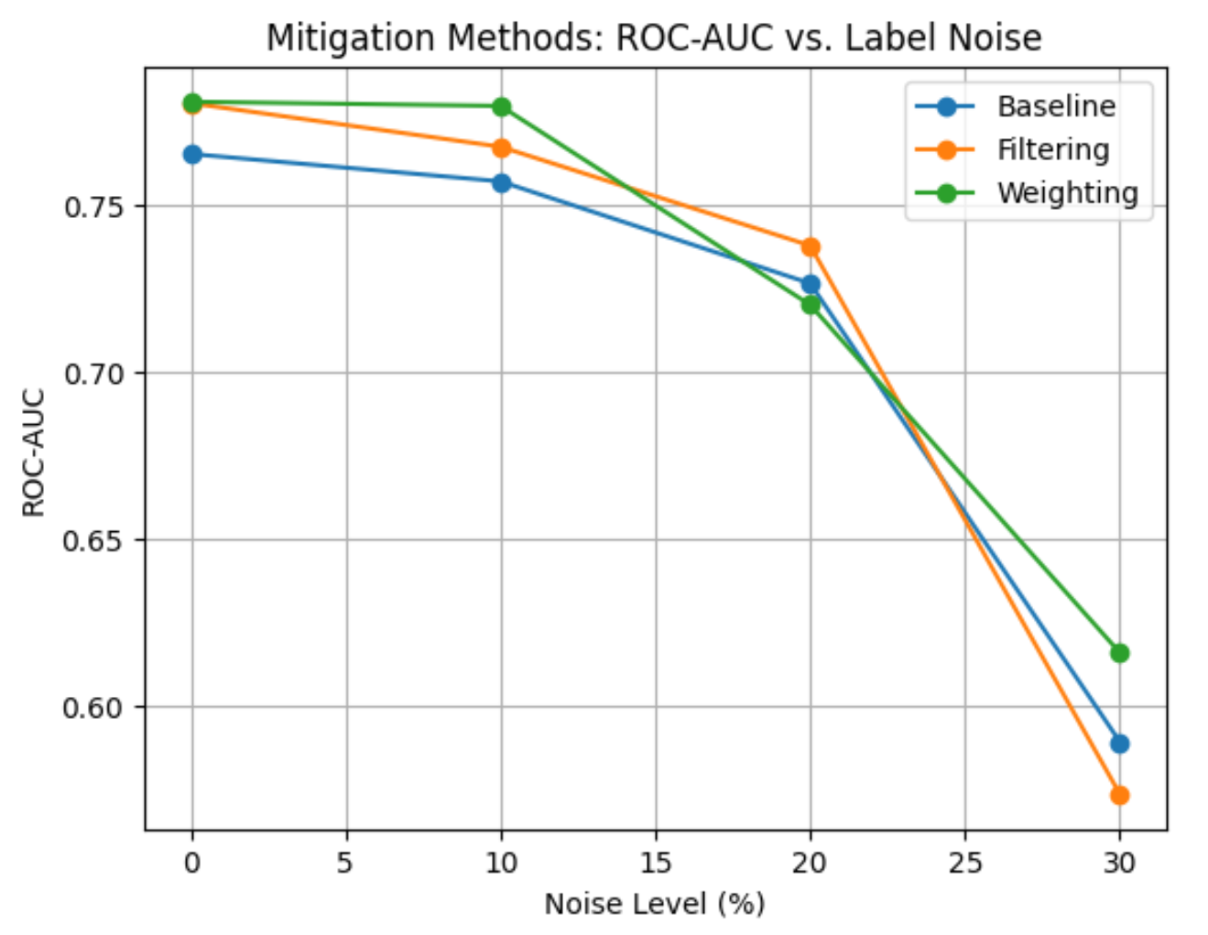
Conclusion
All tree-based models degrade under label noise; boosted methods start stronger but still fall off by 30%.
Instance Weighting delivers the largest AUC recovery (+0.027 at 30% noise), outperforming simple filtering.
LightGBM + weighting offers the best overall robustness across moderate and heavy noise.

